Slide 1


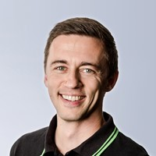


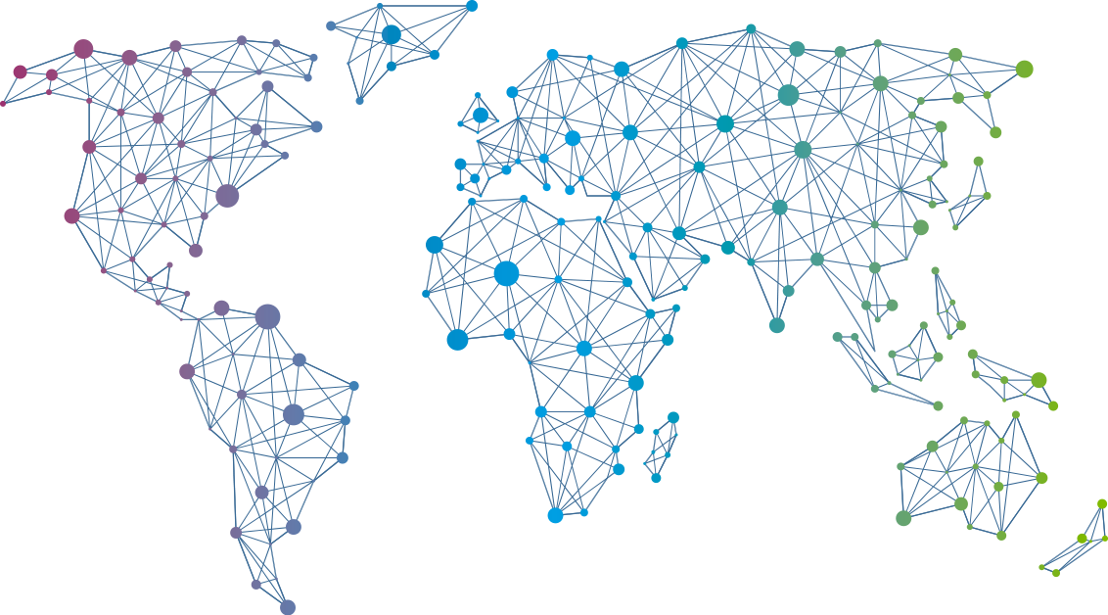

Speaker
Michael Seidl
PowerShell and MS Graph API demystified
Michael Seidl
techguyat
September 16th & 17th
^{Online Event}
Powered By
International Conference

